Slide 1
HK97 Results

Slide 2
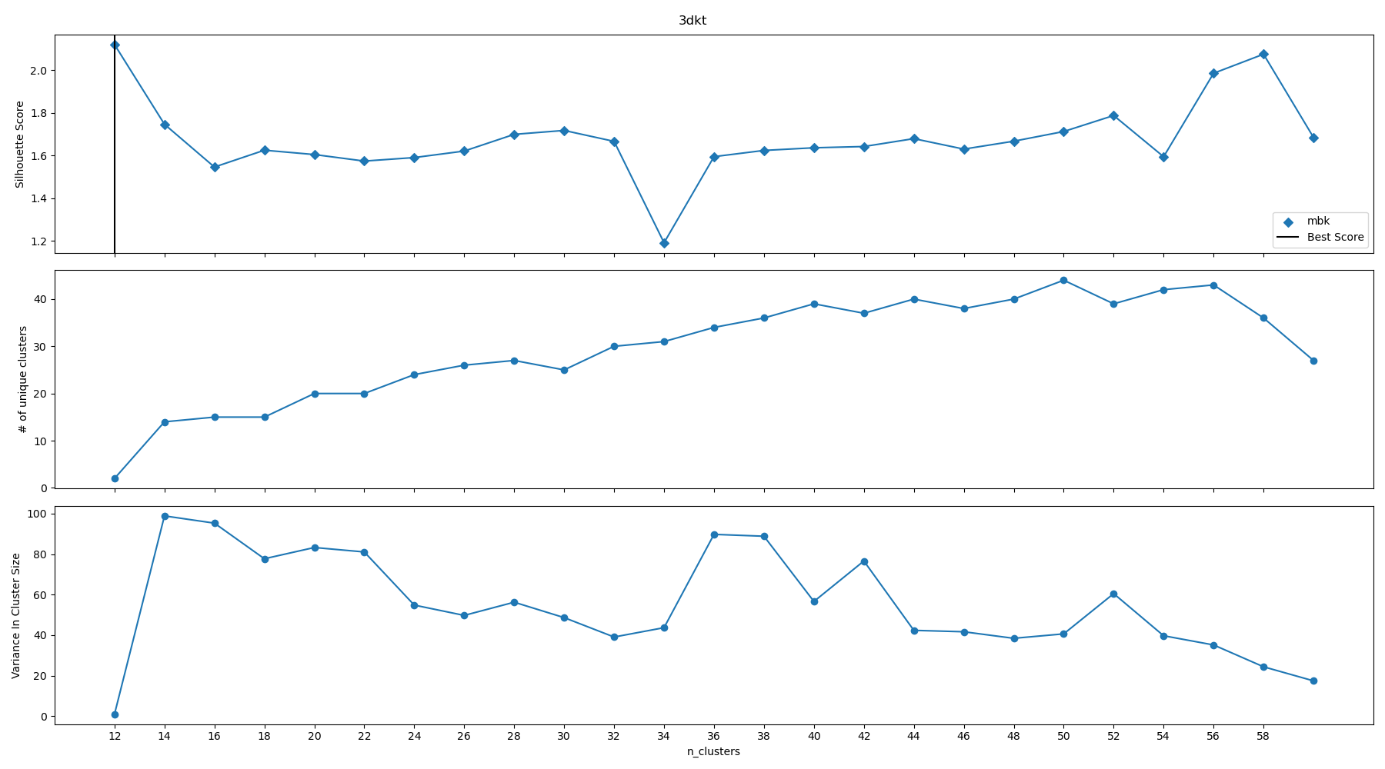
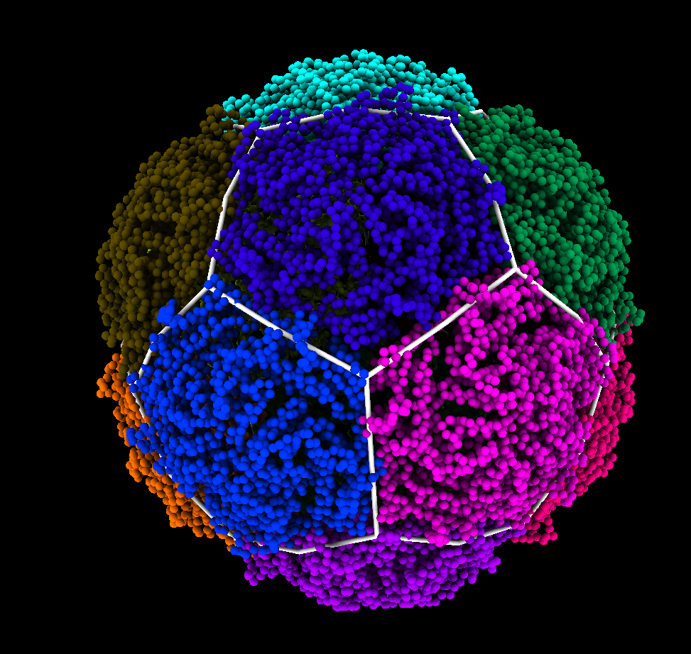
Thermotoga Maritima Encapsulin (3dkt)
T=1 Hexagonal

Slide 3
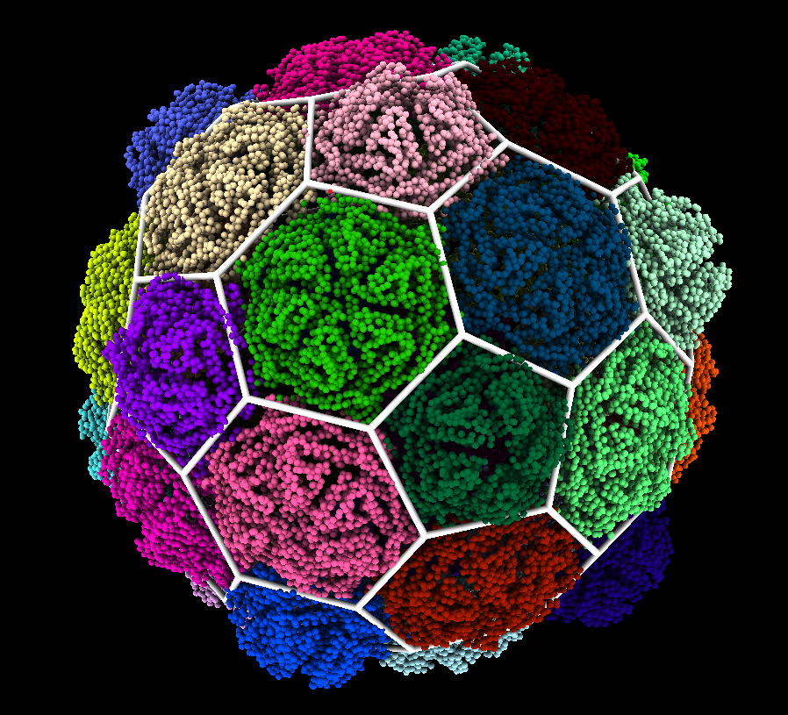
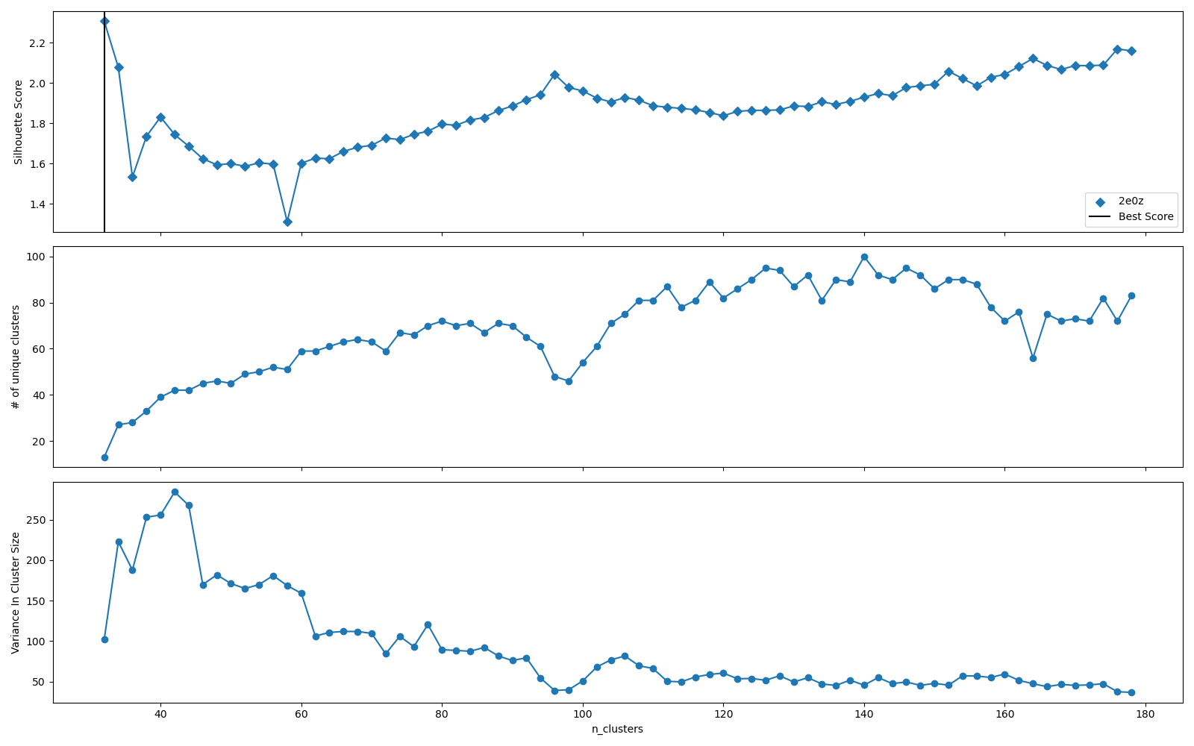
VLP From Pyrococcus Furiosus (2e0z)
T=3 Hexagonal

Slide 4
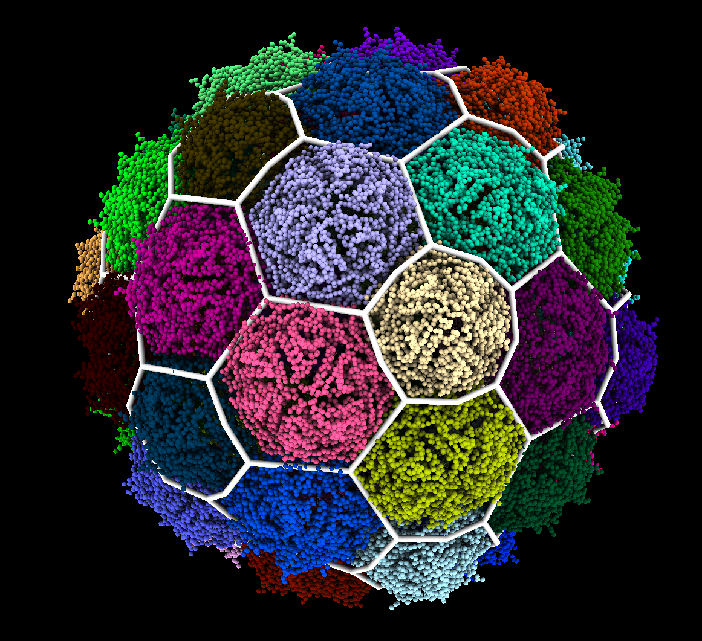
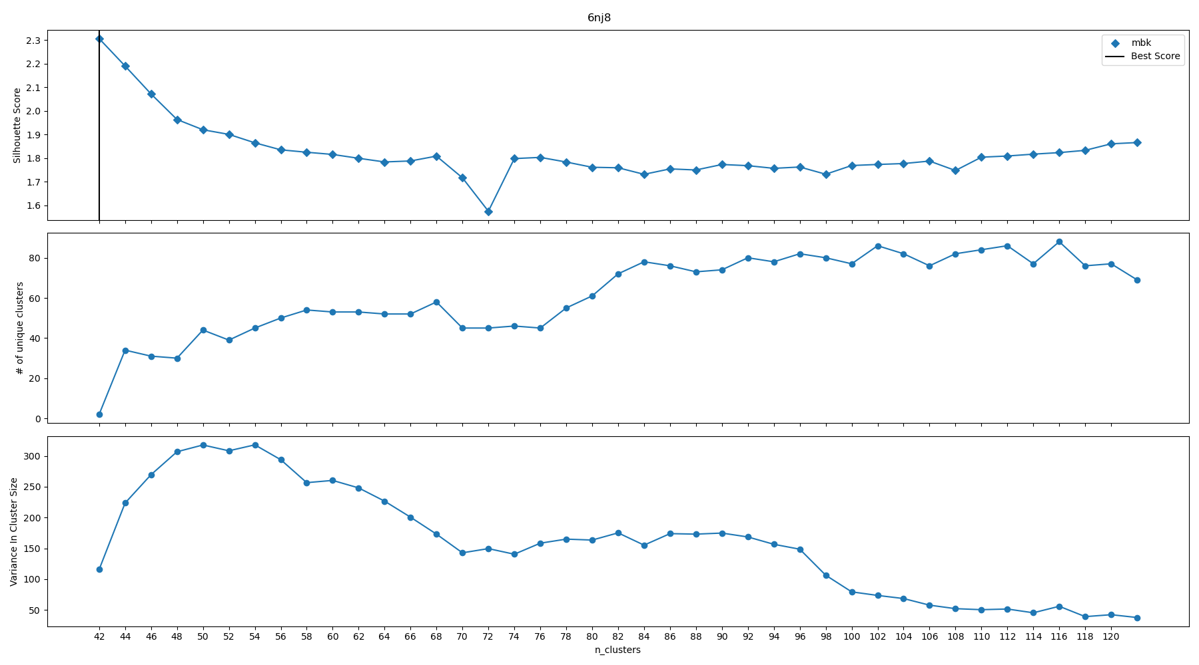
Iron Storage Encapsulin From Quasibacillus thermotolerans (6nj8)
T=3 Hexagonal

Slide 5
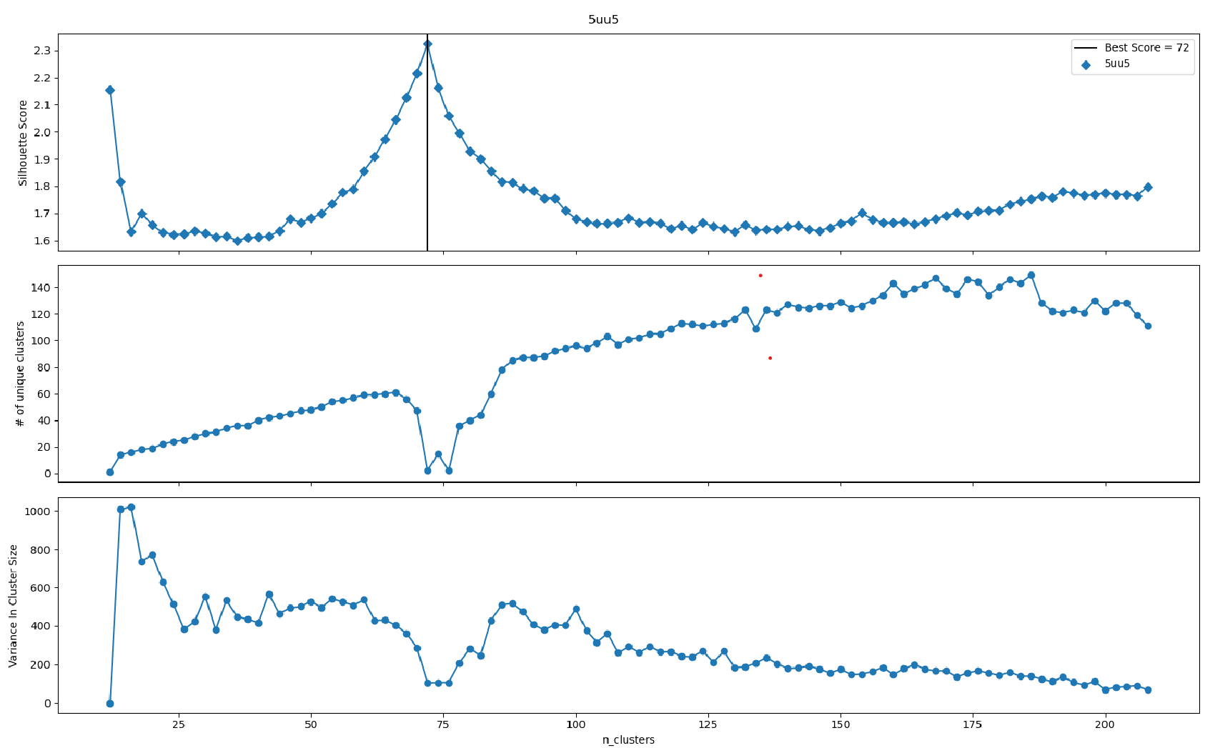
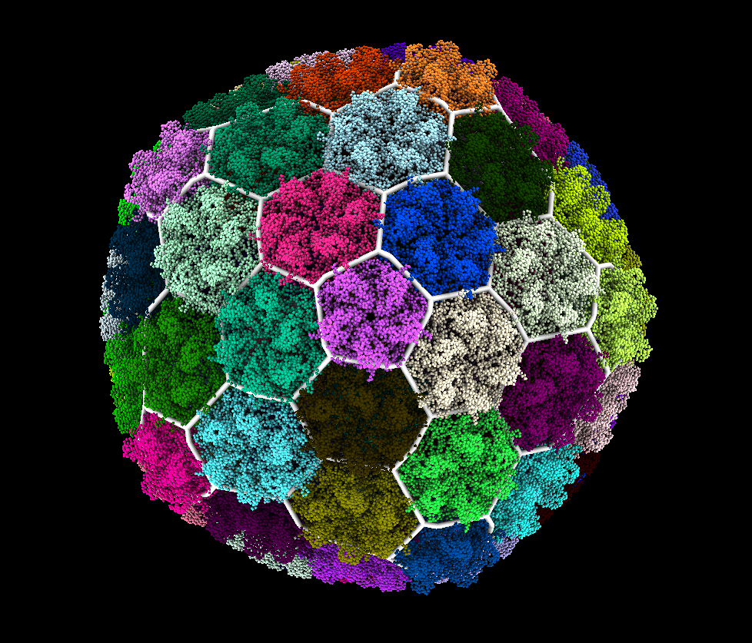
Bacteriopohage P22 Mature Virion (5uu5)
T=7 Hexagonal

Slide 6
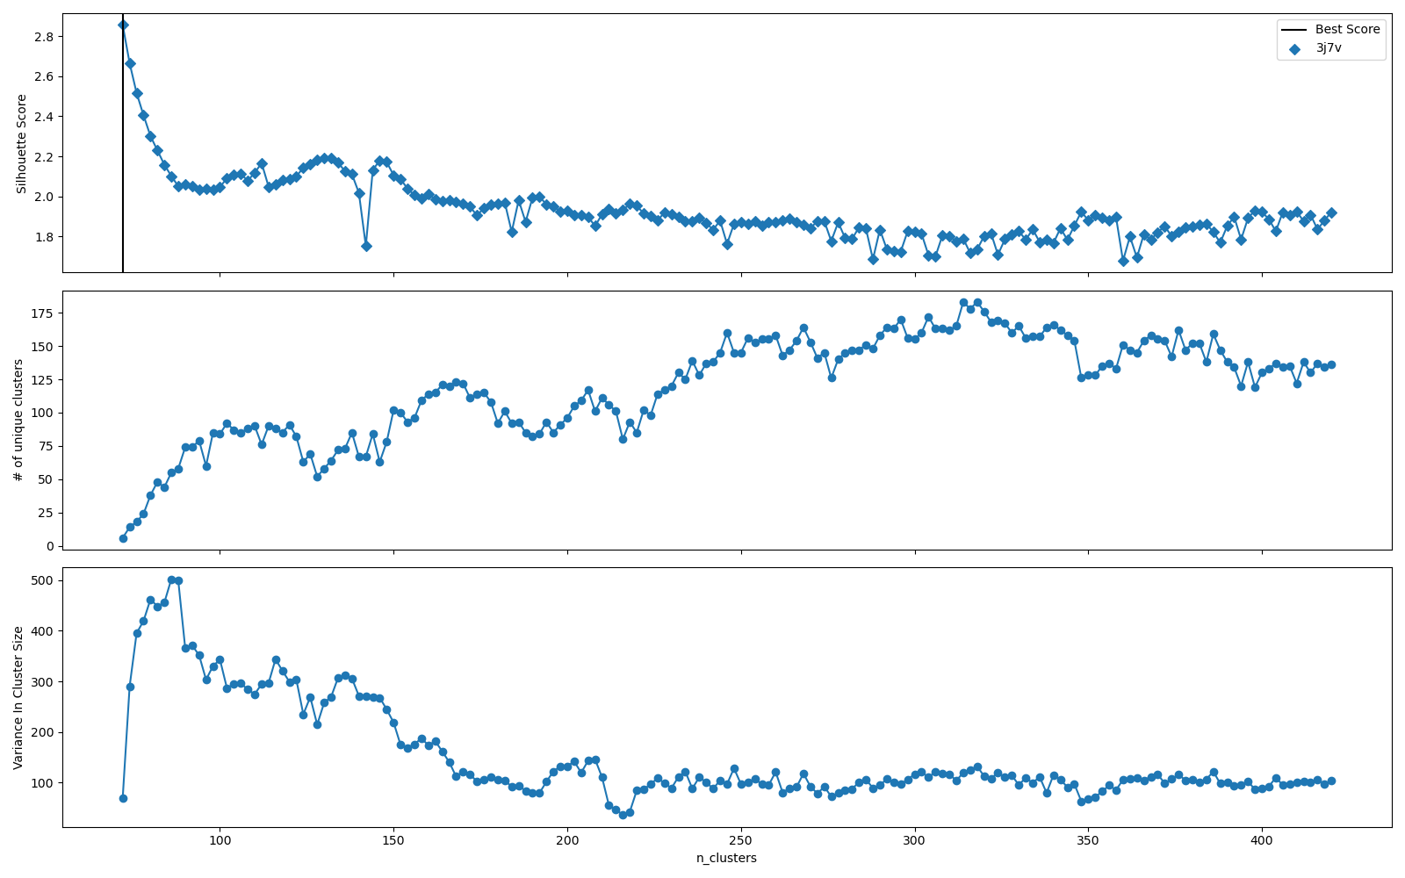
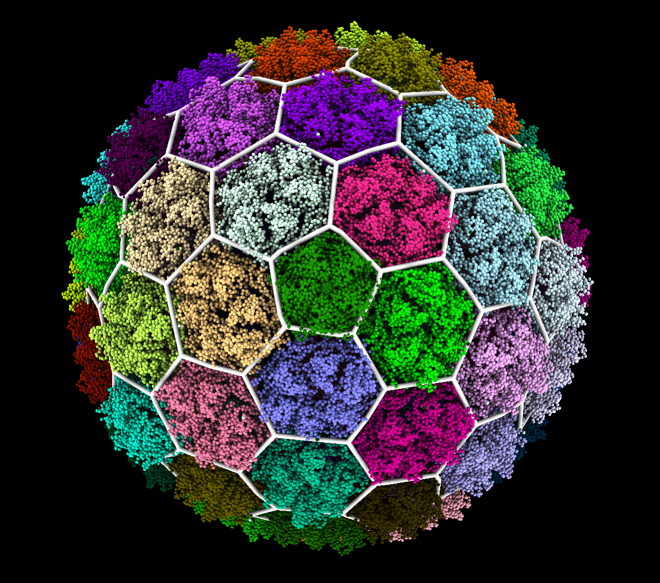
Bacteriopohage T7 Procapsid (3j7v)
T=7 Hexagonal

Slide 7
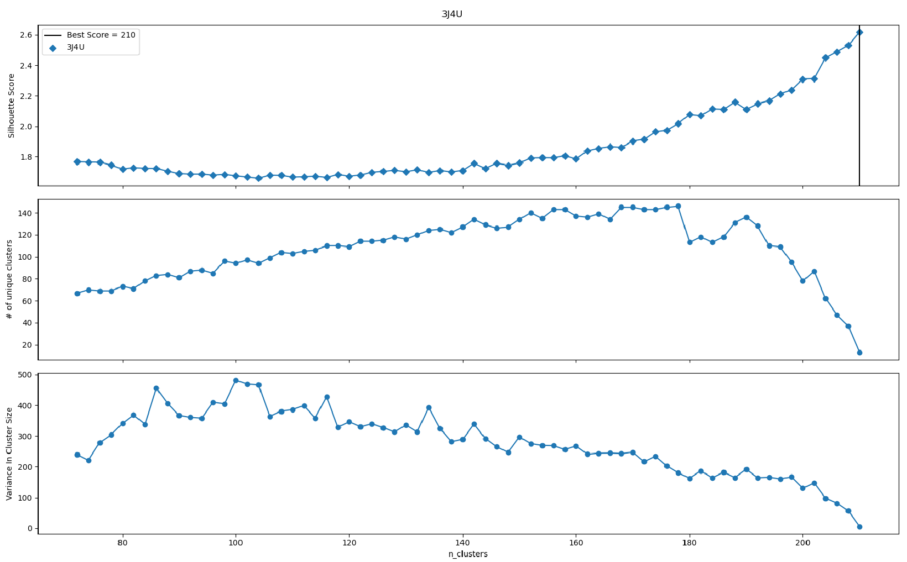
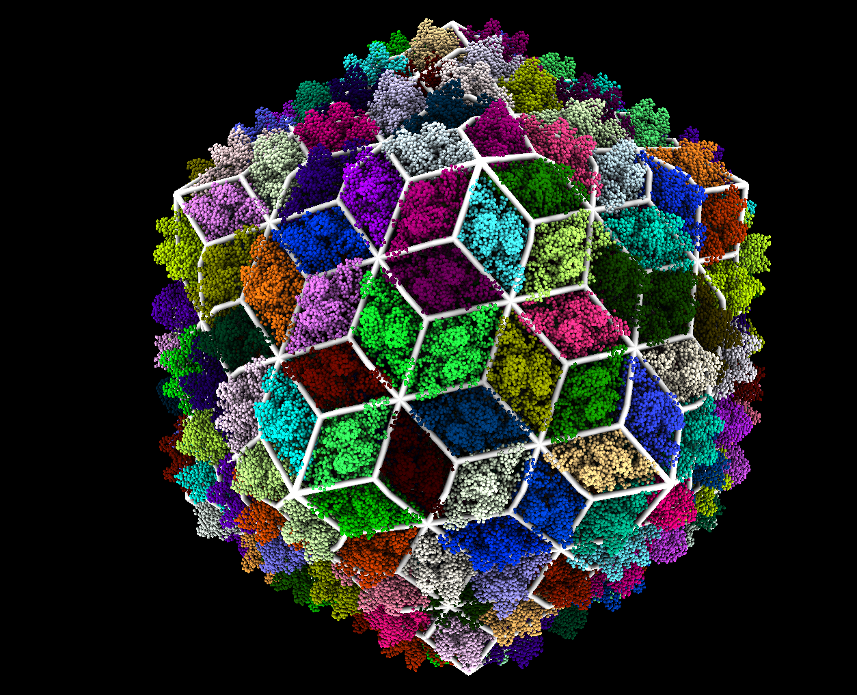
Bordetella Bacteriophage (3j4u)
T=7 Trihexagonal-Dual
(Imperfect Subdivision)

Slide 8
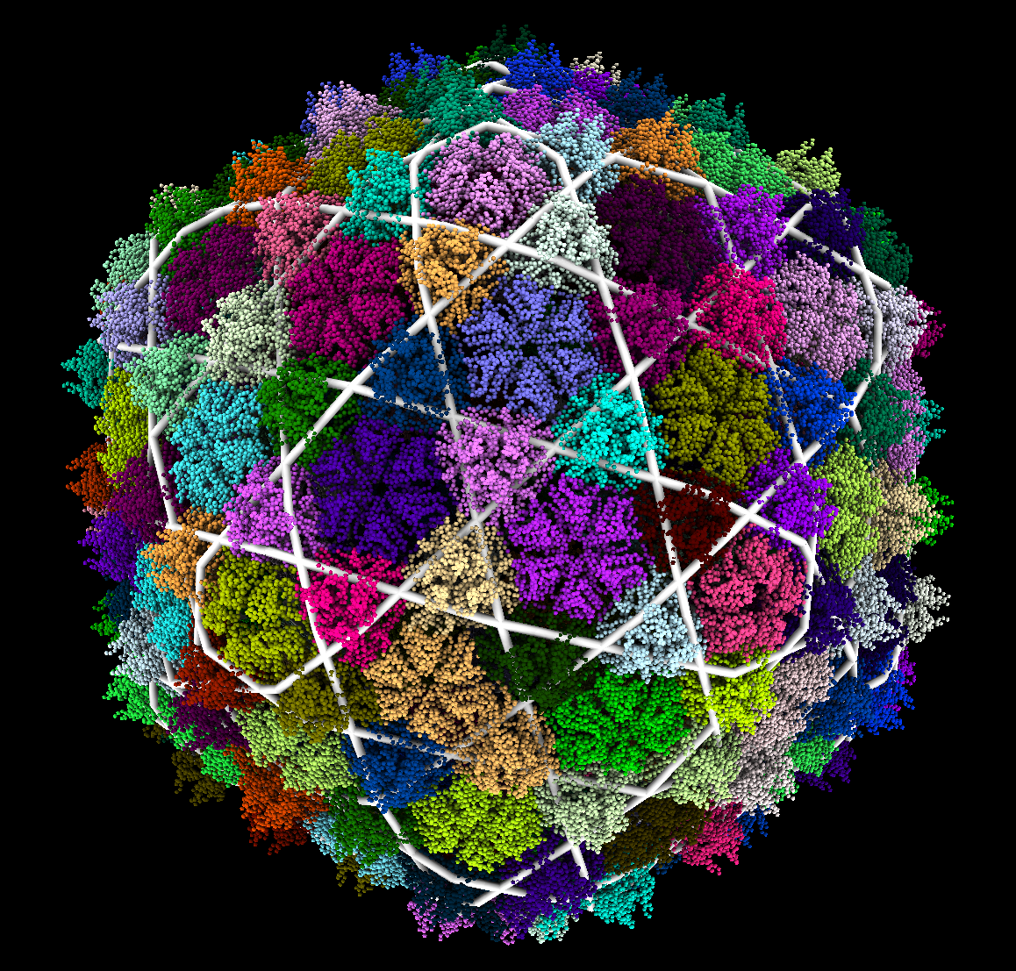
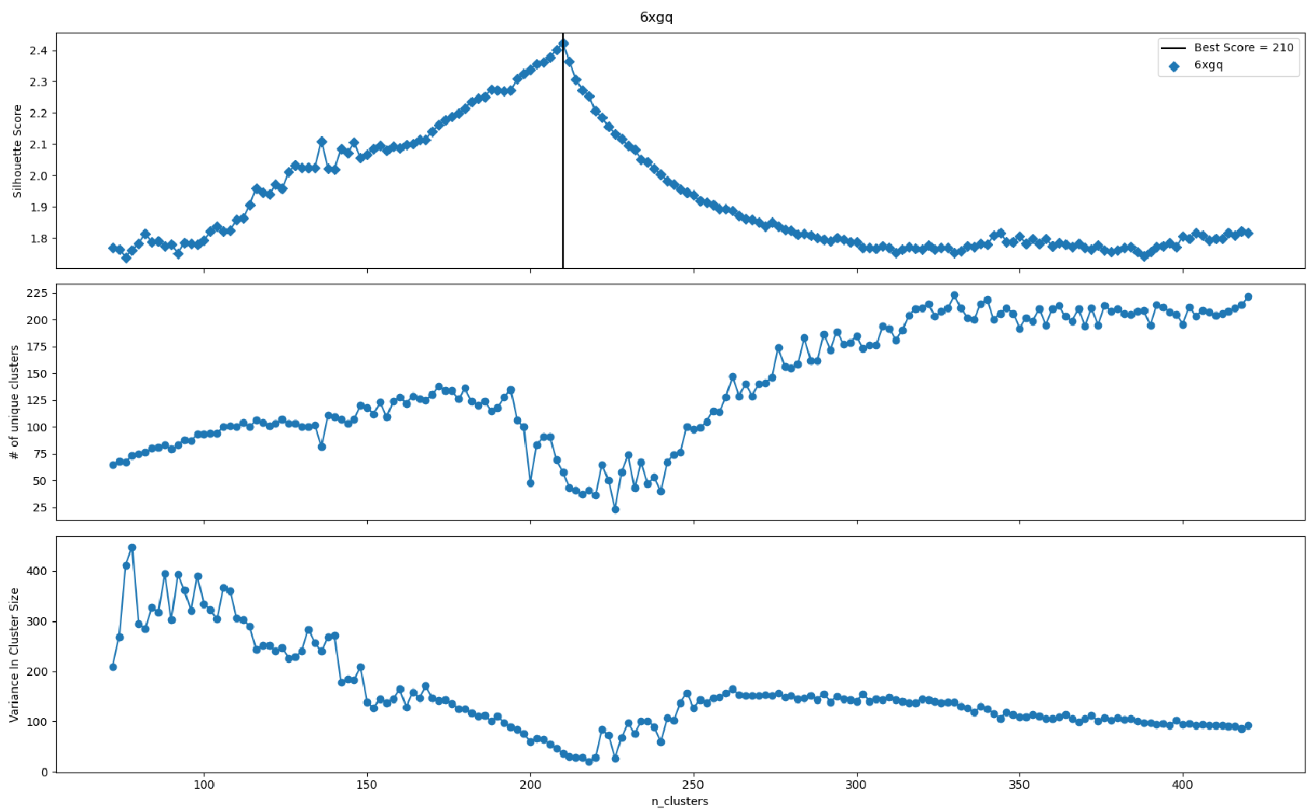
YSD1 Bacteriophage (6xgq)
T=7 Trihexagonal
(Imperfect Subdivision)

Slide 9
Discussion
P22 lacked reinforcement proteins and was labelled as hexagonal
Bordetella and Phage YSD1 had reinforcement proteins around the local 2-fold and 3-fold axes respectively and were labeled as trihex-dual and trihex.
This suggests the presence and location of reinforcement proteins could determine lattice structure.
Both Bordatella and YSD1 had error in their label assignments. The tool becomes less accurate at a large number of clusters.

